Slide 1
Angular Service and Dependency Injection

Slide 2
Service
A service is a typescript class that can be used in multiple components in your Angular application

Slide 3
Advantage of using Service
Reusability of code
Free from redundancy
Communication among multiple components
Easier to use and debug

Slide 4
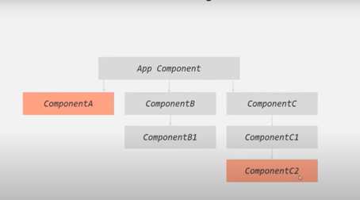
Services communicates among multiple components

Slide 5
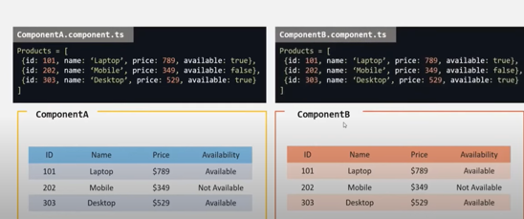
Each components has same array of objects:(Repetition of code)

Slide 6
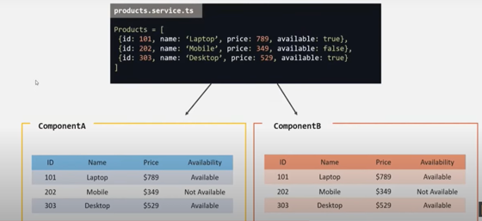
Centrally storing data and sharing among multiple components

Slide 7
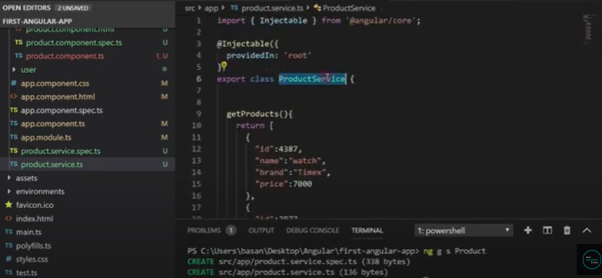
Step 1: create a productservice ng g s productservice

Slide 8
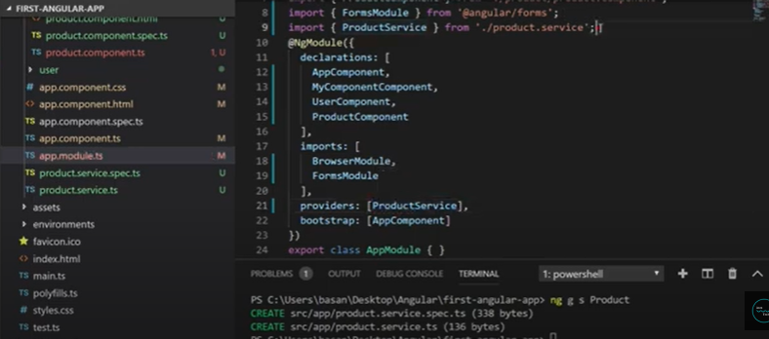
Step 2: Register the service in app.module.ts so that every module can access it

Slide 9
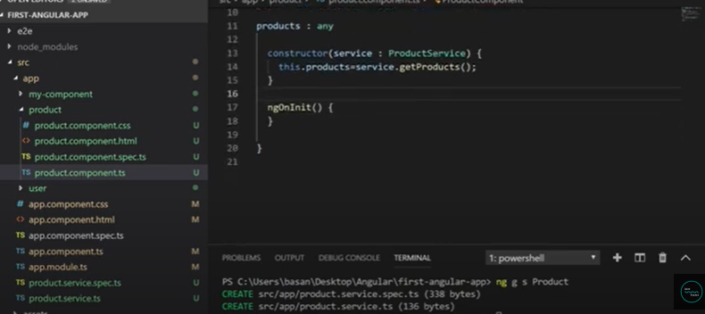
Step 3: inject the service into the product component without hardcoding it

Slide 10
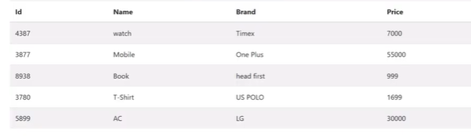
output

